Slide 1
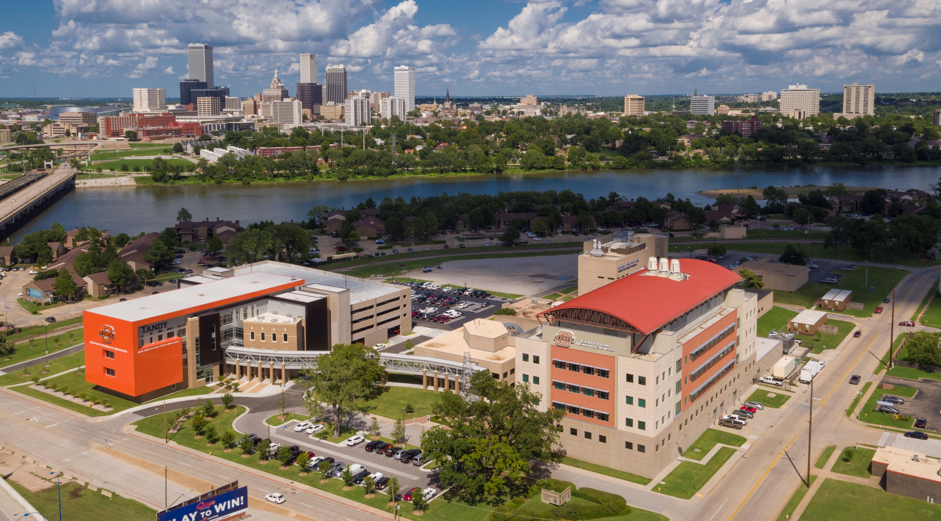

Slide 2
Creating the Learning Environment: COCA Session 3
Angelyn Holmes, Assistant Director of Facilities Management
Heidi Holmes, Interim Assistant Vice President of Information Technology
Sarah Hall, D.O., Associate Professor in Family Medicine

Slide 3
Objectives
To provide an overview of the physical facilities available to students, faculty and staff
To become familiar with the technology resources available at OSU CHS
To understand the interface between the facilities, technology and educational programs delivered to the osteopathic medical students.
To understand the relevance of professionalism, diversity and wellness with respect to the learning environment.

Slide 4

Accreditation Standard 4: Facilities A COM must have sufficient physical facilities, equipment and resources for clinical, research, and technological functions of the COM. These resources must be readily available and accessible across all COM locations to meet its needs, the needs of the students consistent with the approved class size, and to achieve its mission.

Slide 5
Element 4.1: Facilities (CORE) A COM must have facilities for the program of instruction that enable the authorized class size of students and faculty to pursue the mission, curriculum, and scholarly activity of the COM.

Slide 6
1) Facilities are designed with the purpose of providing an opportunity for students to learn.

Slide 7
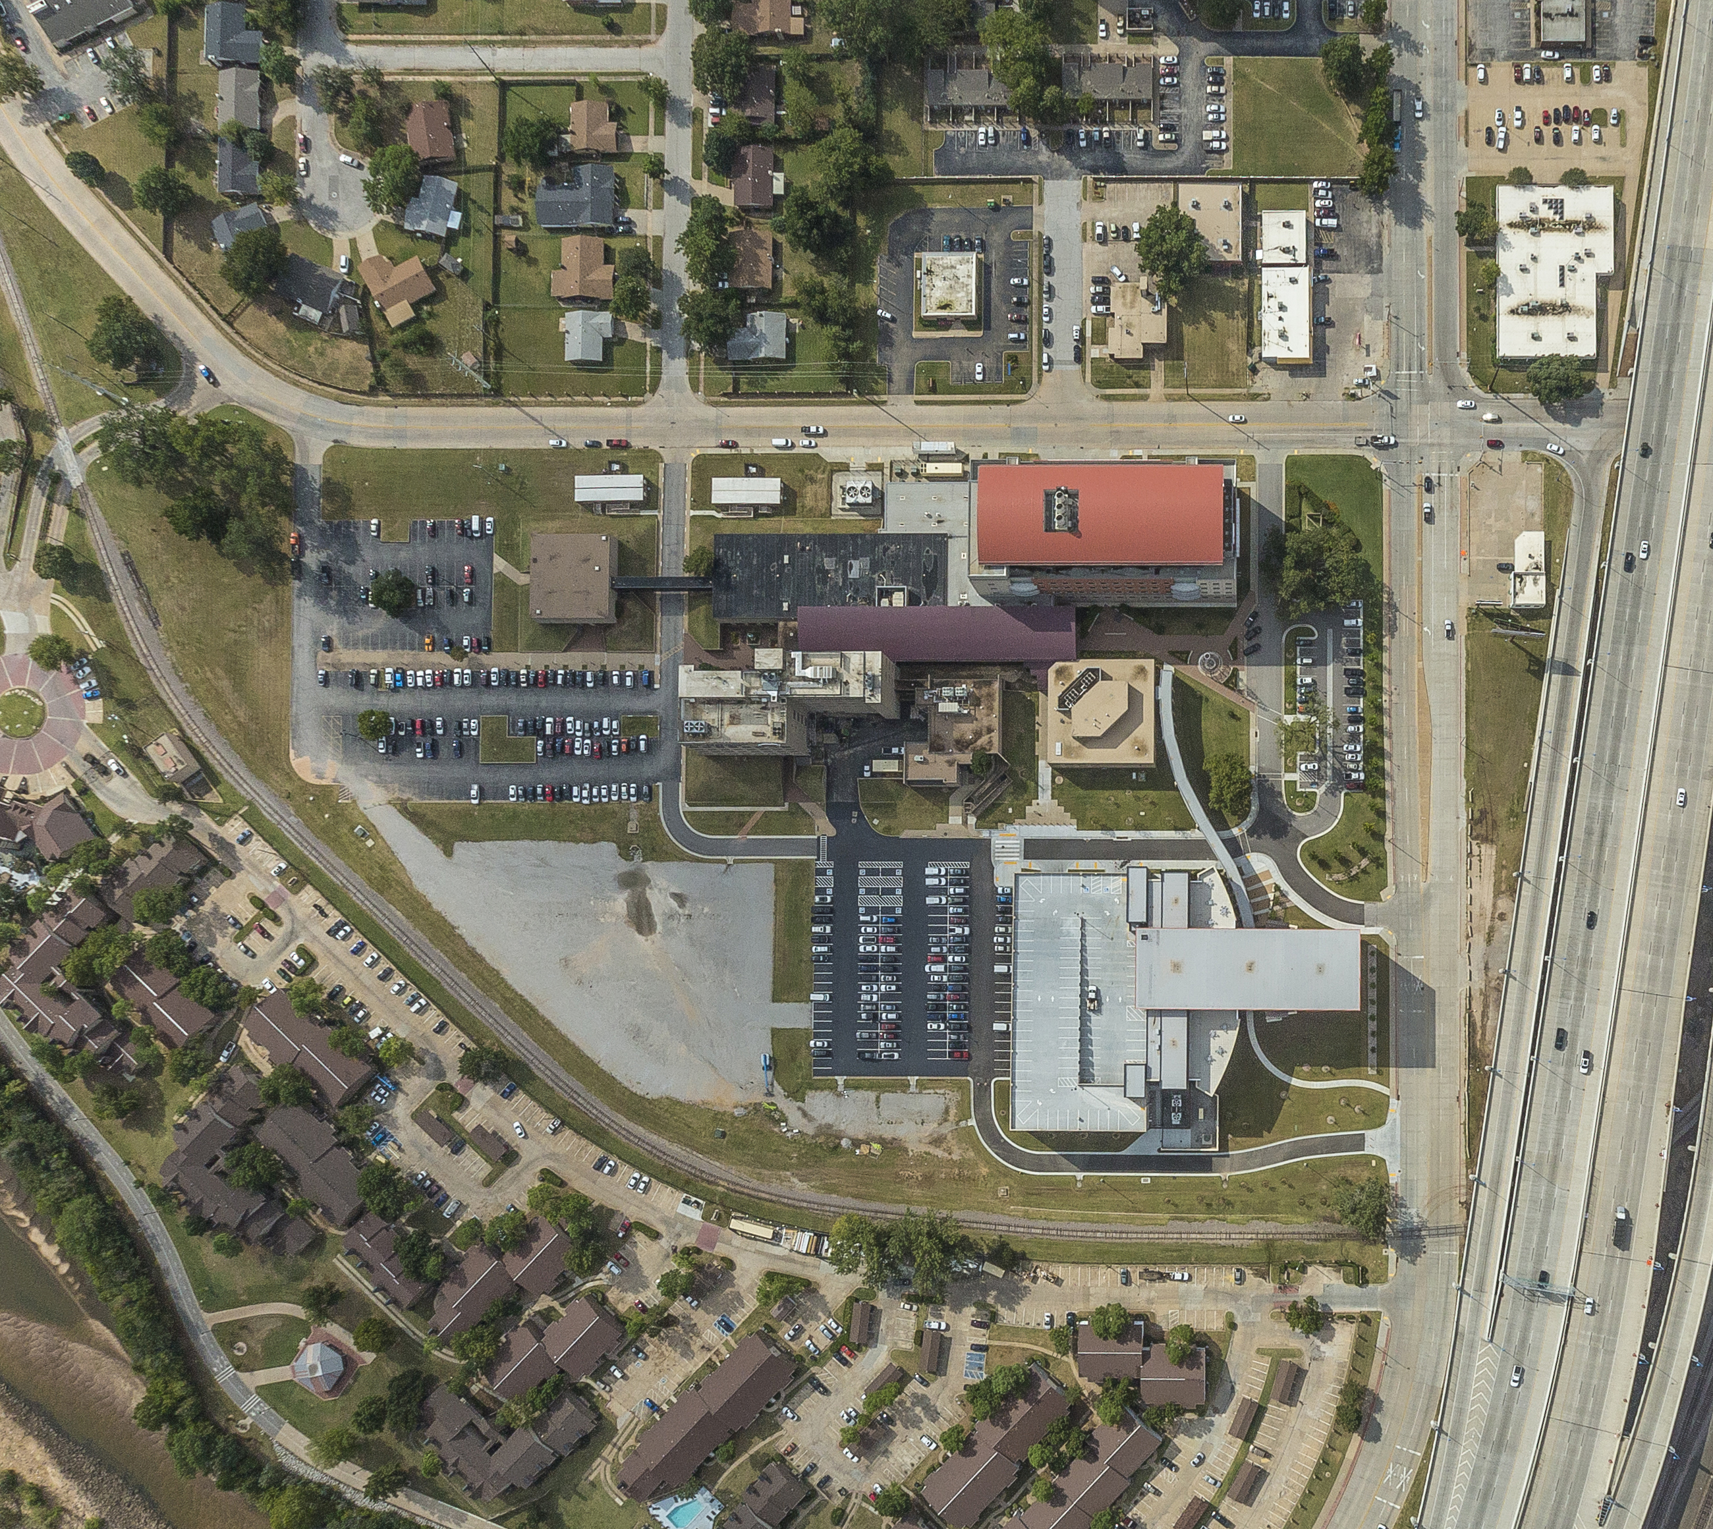

Slide 8
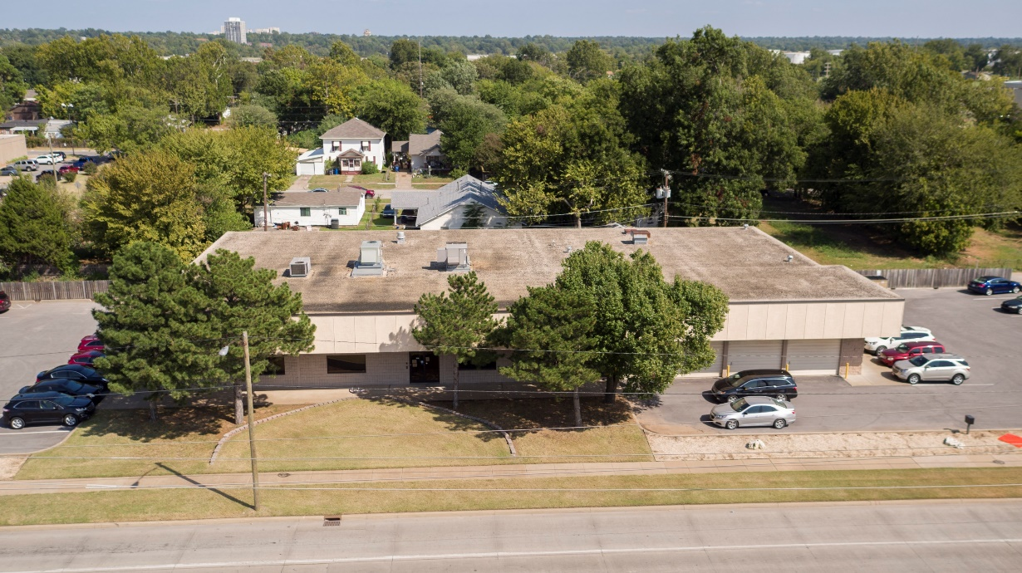
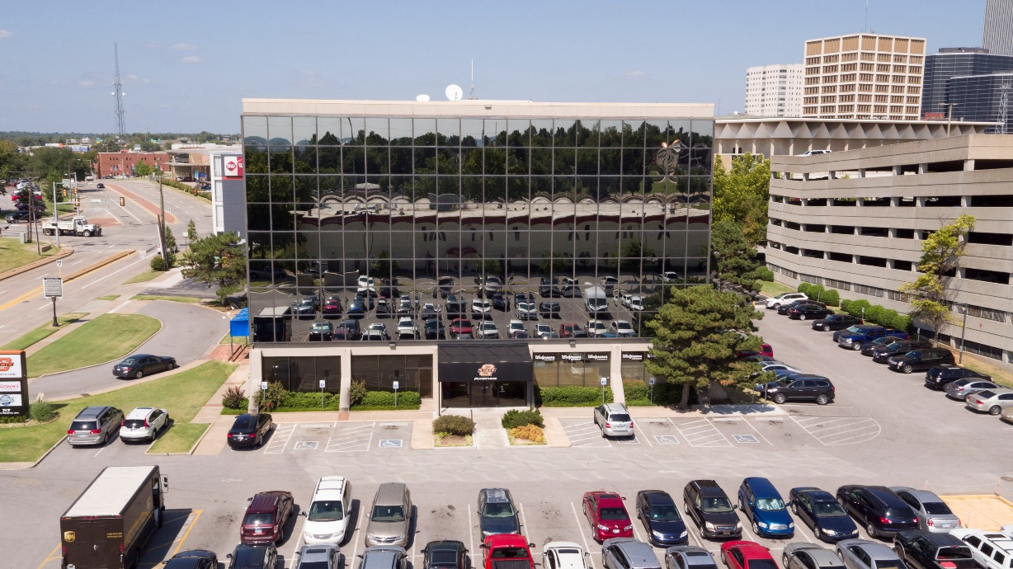
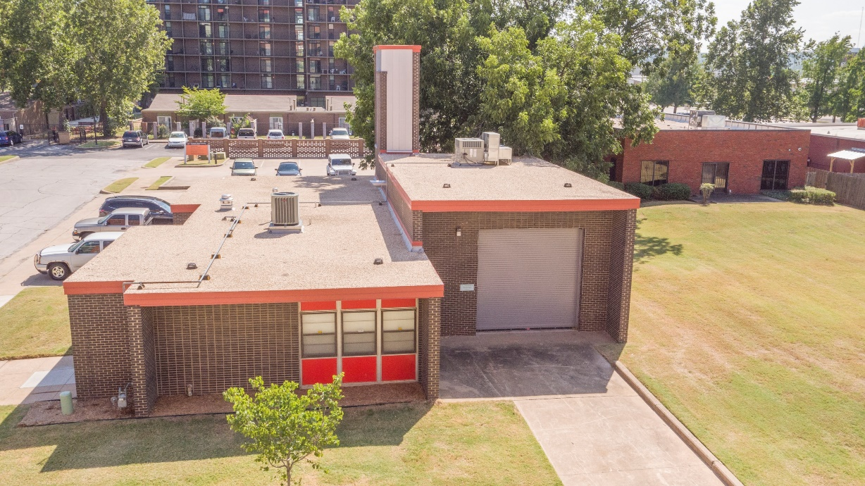
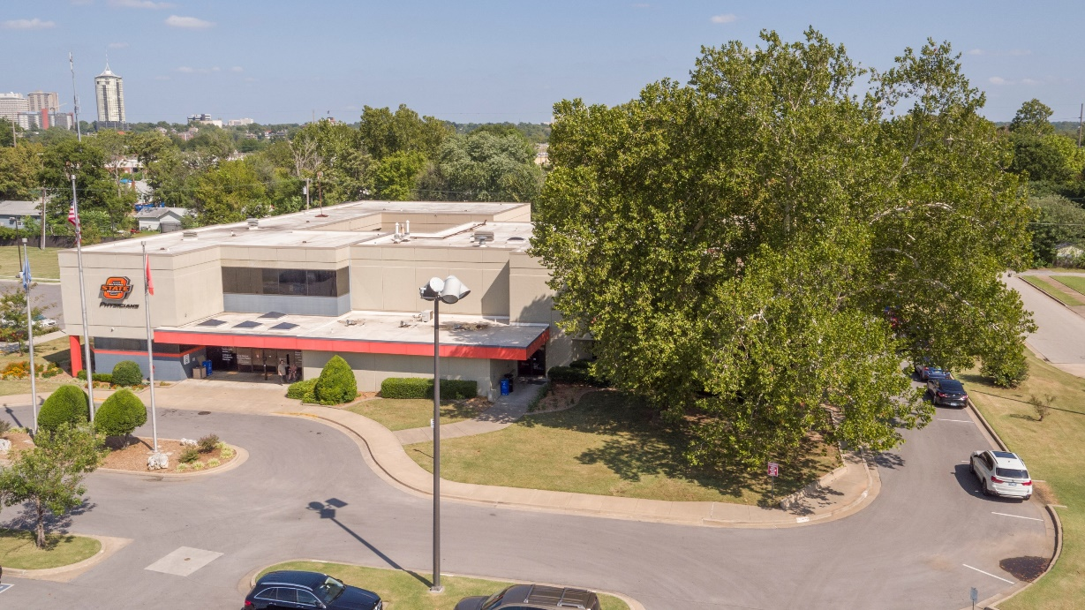

Slide 9
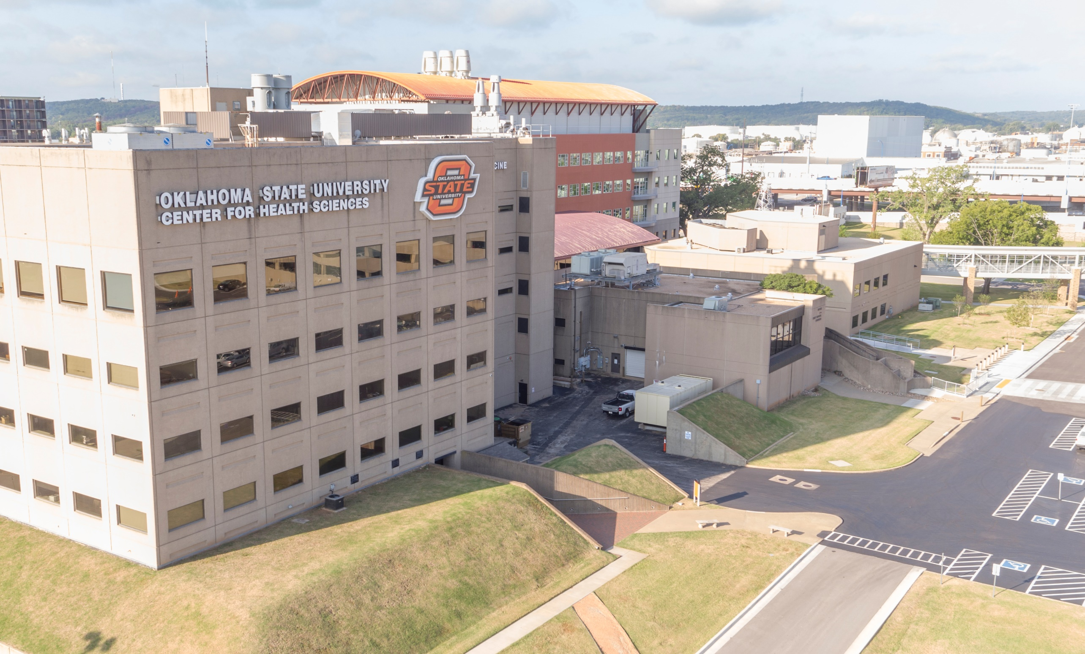

Slide 10
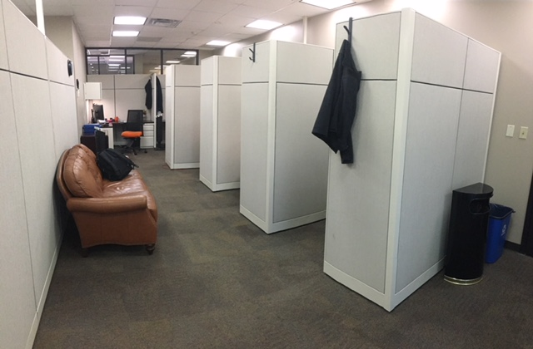

Slide 11
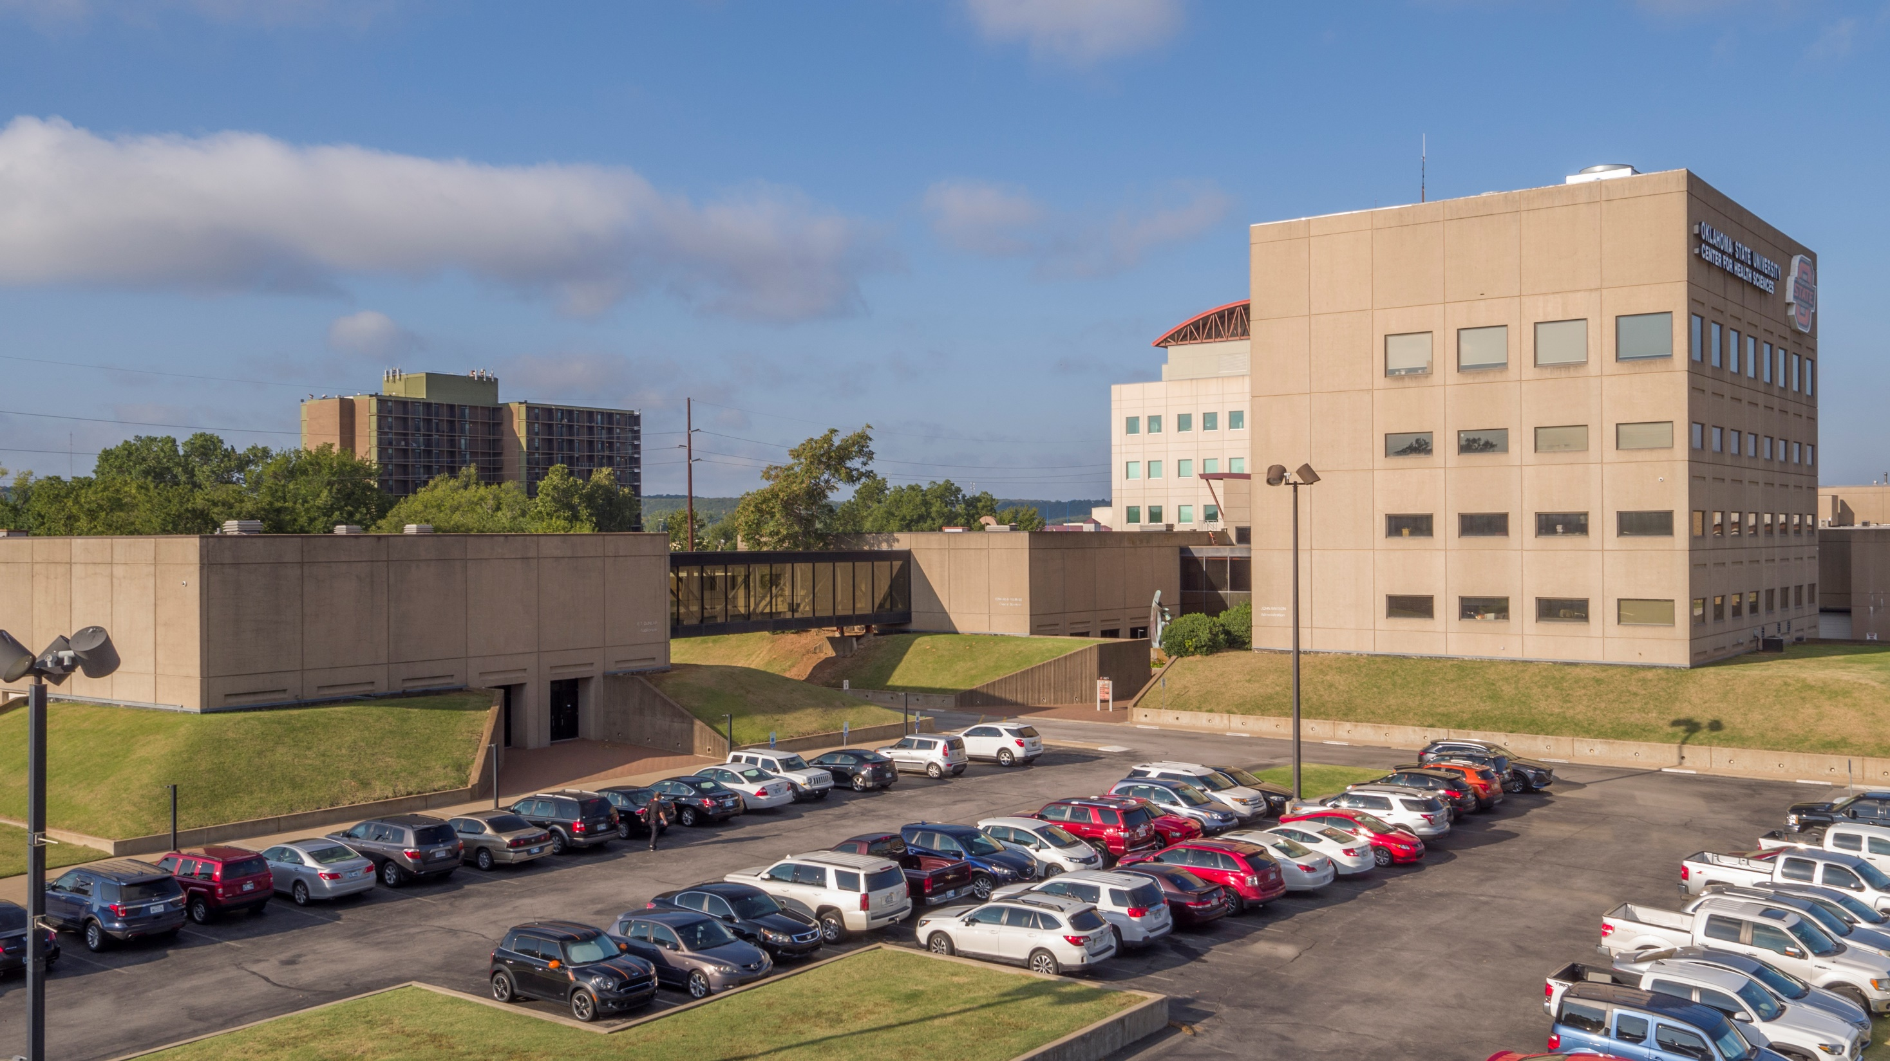

Slide 12
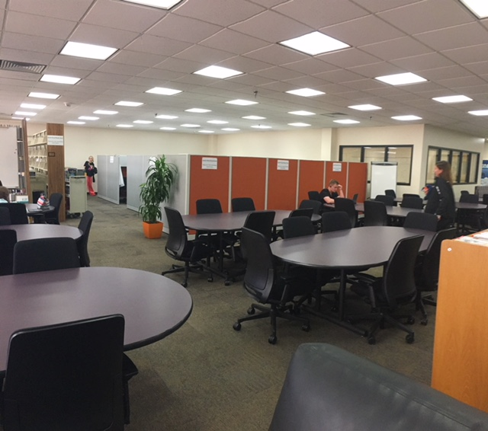
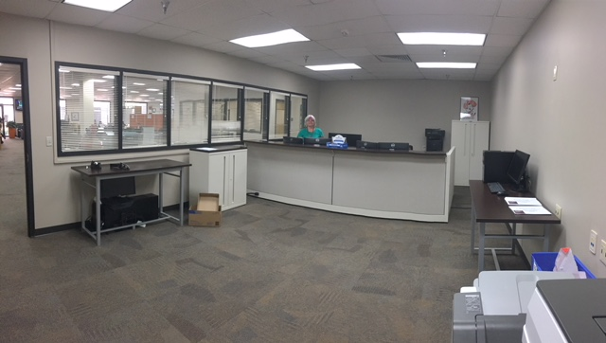
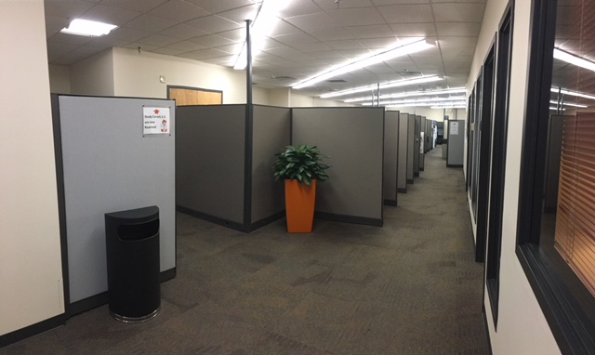

Slide 13
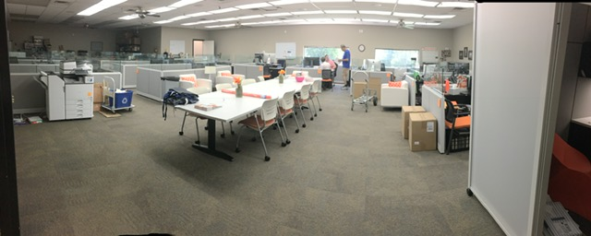

Slide 14
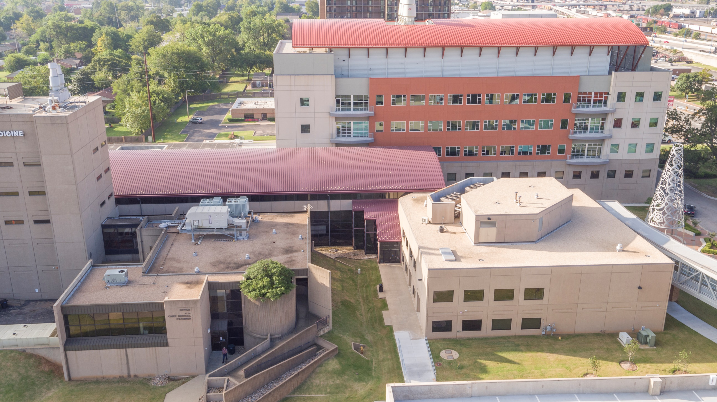

Slide 15
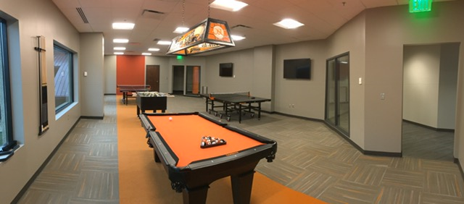
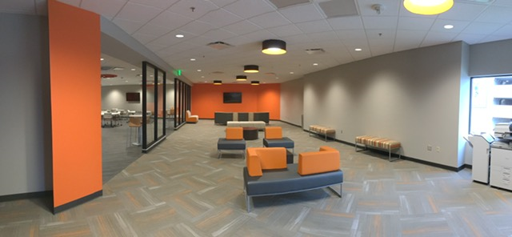
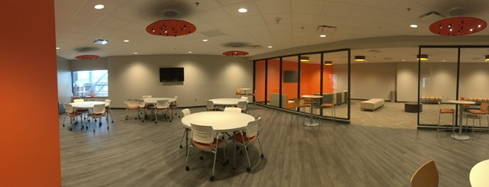
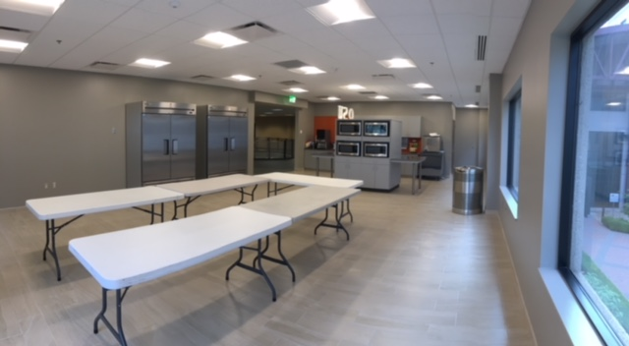

Slide 16
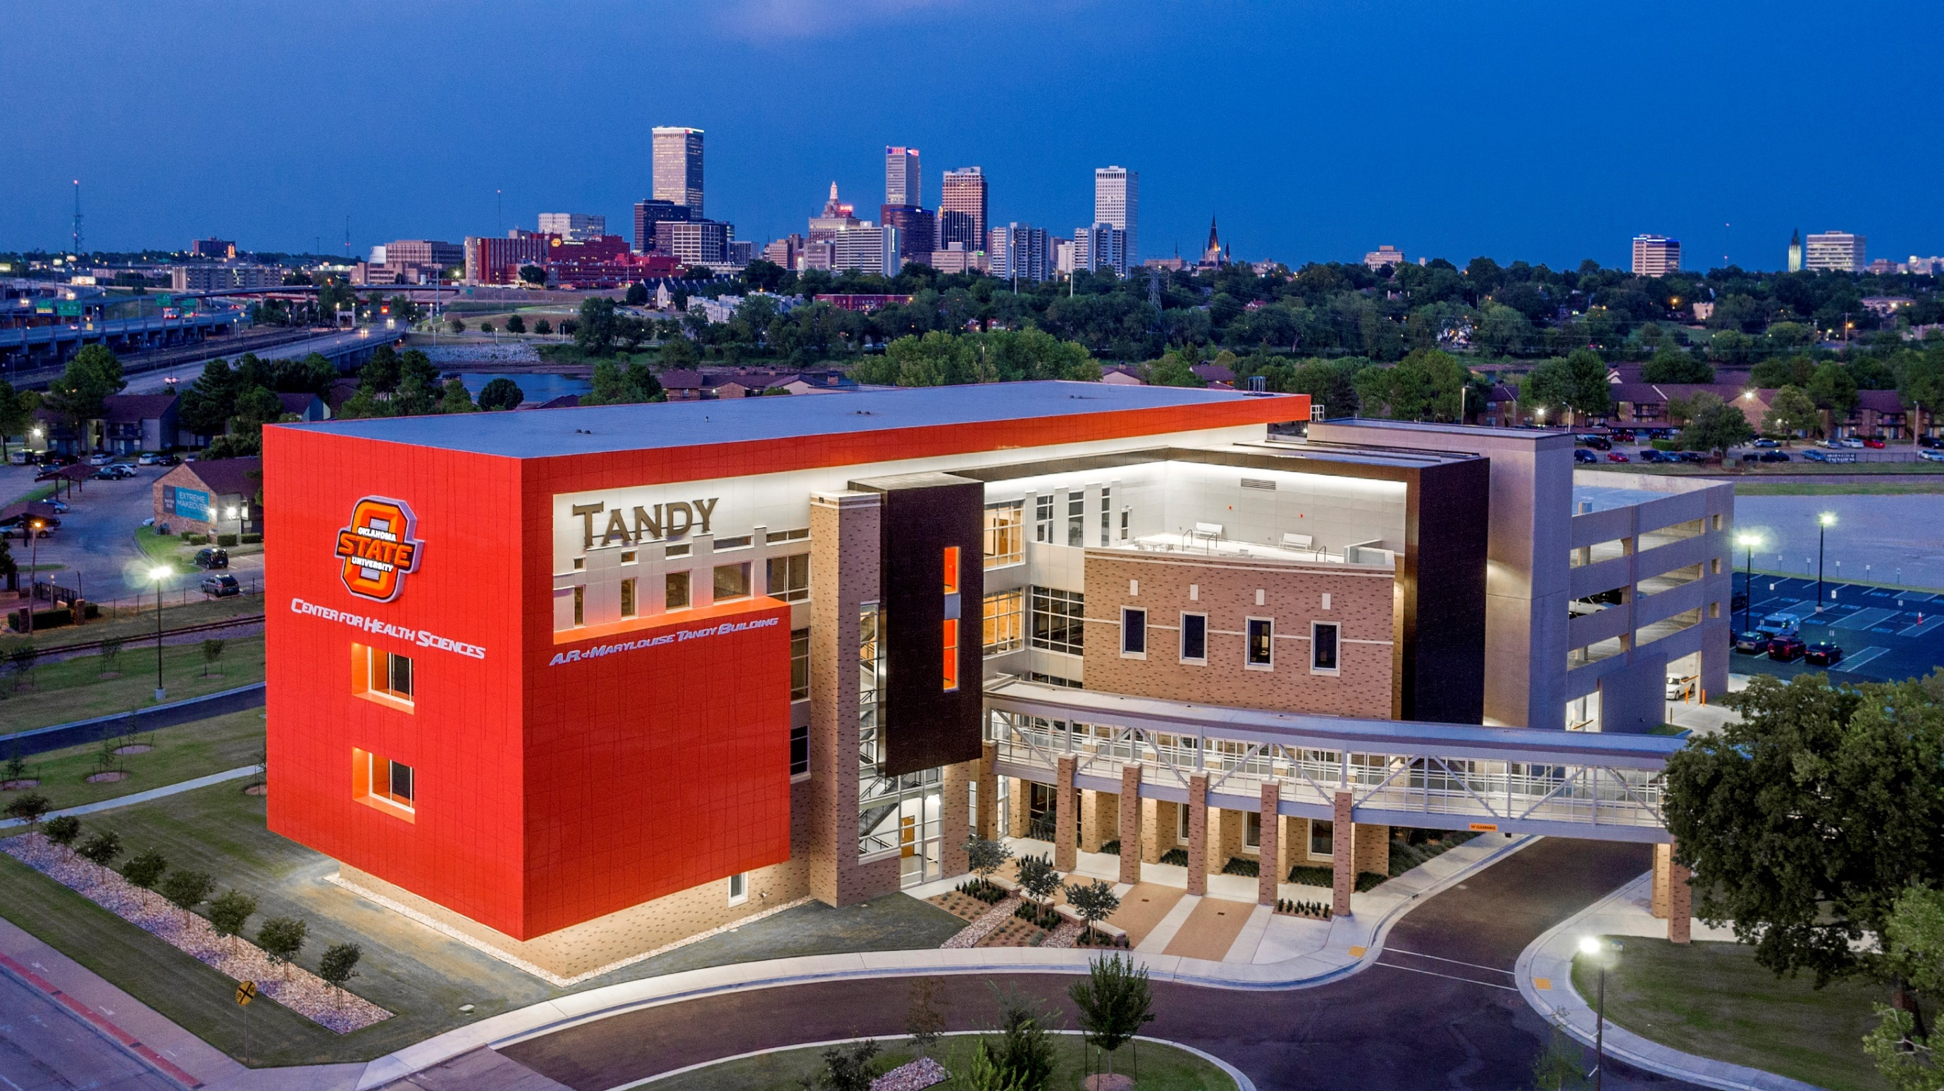

Slide 17
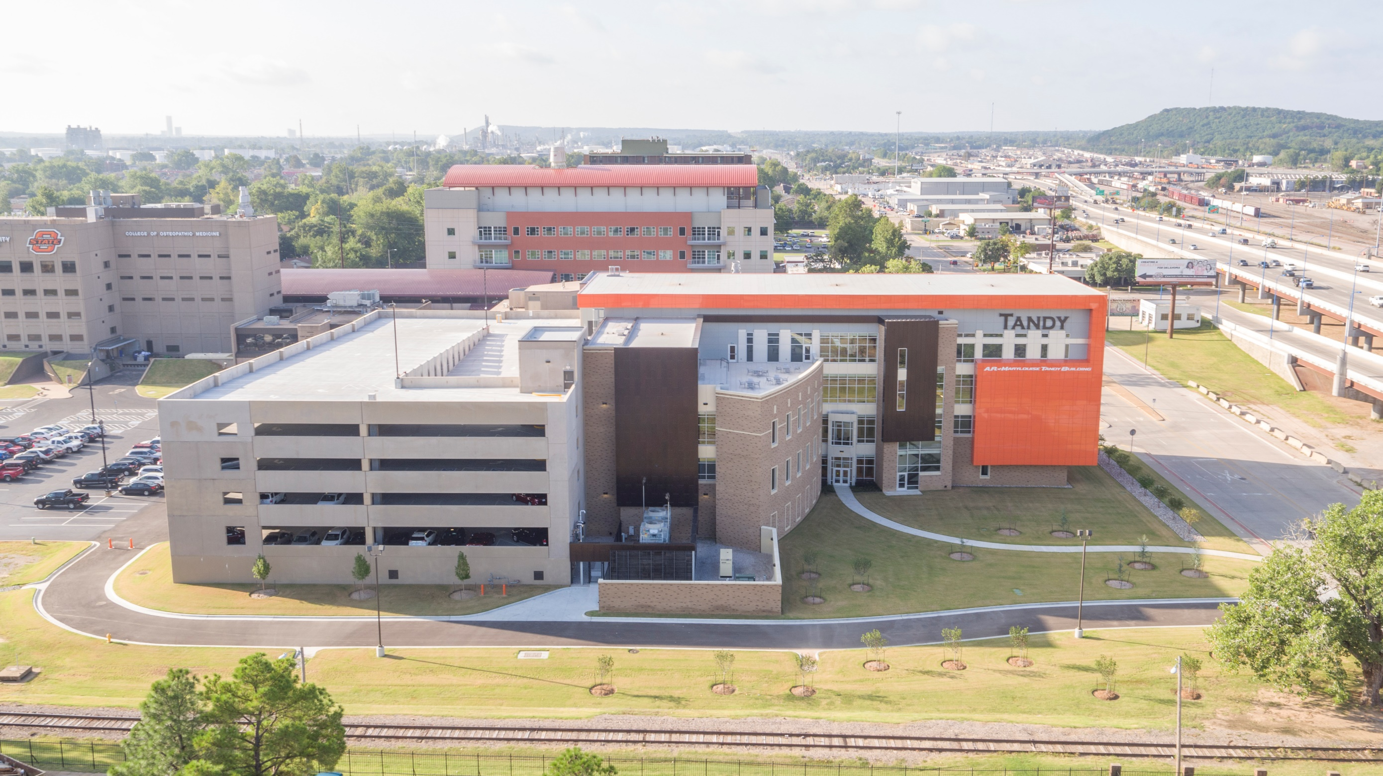

Slide 18
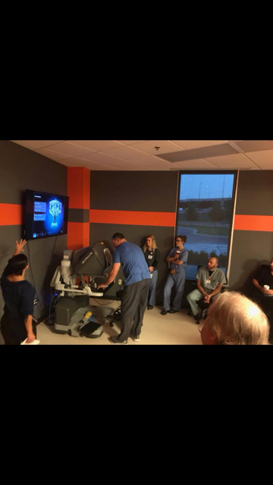
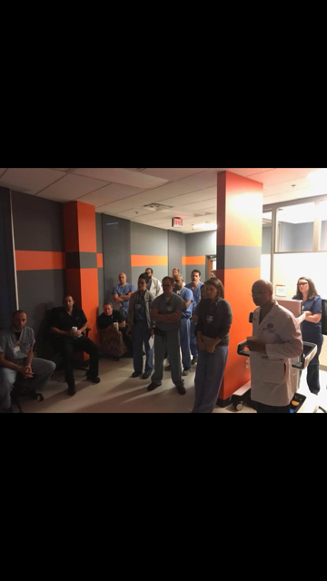
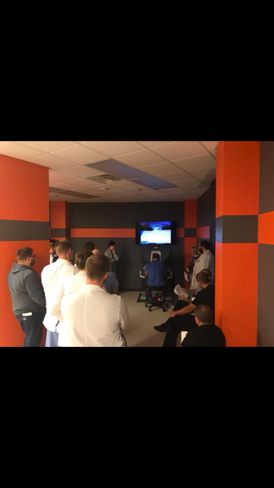

Slide 19
2) Multiple mechanisms are in place to manage the physical facilities.

Slide 20
a) Facilities Management - 15 staff members and multiple outside contracts in place (Housekeeping,
grounds, mechanical, water treatment, etc.)
b) Facilities Management website provides detailed information on services available
c) Routine work request are submitted to the CHS Helpdesk by email chs.helpdesk@okstate.edu or
918-561-1800
d) Facility Use and Planning Committee receives and considers all requests associated with remodels,
moves, painting, space allocation, etc.
e) Energy Conservation Program established in 2007 to promote a culture of campus sustainability
f) Environmental Tours conducted regularly by Safety Manager, Campus Security, Office of Research ,
Occupational Health Nurse and Facilities Management

Slide 21
3) Future buildings designed to mirror existing facilities and provide the same opportunities for student learning

Slide 22
a) Campus Master Plan b) Master Landscape Plan c) OSU COM CN

Slide 23
Element 4.2: Security and Public Safety: A COM must ensure that adequate security systems are in place and publish and follow policies and procedures for security; faculty, staff and student safety and emergency and disaster preparedness at all COM operates teaching and training locations.

Slide 24
Accreditation Standard 4.3 Information Technology

Slide 25
4.3 Information Technology
4.3. A COM must ensure access to Information Technology to support its mission.
CHS Information Technology
24 IT/HIT Professionals
CHS I.T. supports a large network comprised of latest hardware and software technology
Locations supported: 12
1000 +end point devices (workstations and laptops)
150+ Servers
150 + Wireless access points
300+ Printers
300 Testing mobile devices
1400 +Users

Slide 26
4.3 Information Technology
CHS Helpdesk
Requests or incidents can be submitted to our CHS Helpdesk via telephone (918-561-1800), by email at chs.helpdesk@okstate.edu or in person at the CHS Helpdesk office located inside the CHS Library.
Service catalog
Network access and support
Desktop Support and Classroom Technology Support
Storage – Network Shared files
Data backups
Application selection, implementation and support
Data analytics
Email Services
System updates, network monitoring and security

Slide 27
4.4 Learning Resources
A COM must ensure access to learning resources to support its mission.
Available infrastructure in classrooms
Multiple screens
Multiple inputs , instructors can share from multiple devices
Air Media Share the screens
Wifi
Recording session software, video conference software
Mics on desks
File Share
VR Software in reboot center

Slide 28
4.4 Learning Resources
CHS Data center
Network redundancy and DR
Enhancement of Network security and redesign
VOIP
Tahlequah campus

Slide 29
Accreditation Standard 5: The Learning Environment

Slide 30
The Learning Environment
“A COM must ensure that its educational program occurs in professional, respectful, non-discriminatory, and intellectually stimulating academic and clinical environments. The school also promotes student’s attainment of osteopathic core competencies required for future osteopathic physicians.”

Slide 31
5.1 Professionalism (CORE)
“A COM must ensure that the learning environment of its osteopathic medical education program is conducive to the on-going development of professional behaviors in its osteopathic medical students, faculty, and staff at all locations and is one in which all individuals are treated with respect. This should also include aspects of patient safety, cultural competence and interprofessional collaborative practice.”

Slide 32
5.1 Professionalism
https://osteopathic.org/about/leadership/aoa-governance-documents/code-of-ethics/
Voted on annually at the general faculty meeting
https://health.okstate.edu/hr/professional-development.html
Professional development for faculty and staff

Slide 33
5.1 Professionalism
Students recite the osteopathic oath at their white coat ceremonies and at graduation
Issuance of Non cognitive grade for unprofessional behaviors
Academic standards determines next steps or recommendations

Slide 34
Osteopathic Oath
I do hereby affirm my loyalty to the profession I am about to enter. I will be mindful always of my great responsibility to preserve the health and the life of my patients, to retain their confidence and respect both as a physician and a friend who will guard their secrets with scrupulous honor and fidelity, to perform faithfully my professional duties, to employ only those recognized methods of treatment consistent with good judgment and with my skill and ability, keeping in mind always nature’s laws and the body’s inherent capacity for recovery.
I will be ever vigilant in aiding in the general welfare of the community, sustaining its laws and institutions, not engaging in those practices which will in any way bring shame or discredit upon myself or my profession. I will give no drugs for deadly purposes to any person, though it be asked of me.
I will endeavor to work in accord with my colleagues in a spirit of progressive cooperation and never by word or by act cast imputations upon them or their rightful practices.
I will look with respect and esteem upon all those who have taught me my art. To my college I will be loyal and strive always for its best interests and for the interests of the students who will come after me. I will be ever alert to further the application of basic biologic truths to the healing arts and to develop the principles of osteopathy.

Slide 35
5.1 Professionalism
Crucial Conversations
Communication and Conflict management
https://www.youtube.com/watch?v=UX-ArZJJJ1U
Service Learning and Community Engagement
https://health.okstate.edu/service-learning/index.html
Clinical Care Foundations
Simulations
Small groups centered on professionalism and interprofessional teams
Required Clerkships
CSMHP – "Center for Sports Medicine and Human Performance” promotes Interprofessional collaborative practices

Slide 36
5.2 Diversity
“A COM must publish and follow policies to achieve mission appropriate diversity outcomes among its students, faculty, senior administrative staff, and other relevant members of the academic community.”

Slide 37
5.2 Diversity
Oklahoma State University is a land-grant institution committed to excellence in diversity and inclusion.
We strive to maintain a welcoming and inclusive environment that appreciates and values all members of the University community.
We define diversity as engagement in meaningful actions, behaviors, and conversations that reflect a commitment to recognizing, understanding, and respecting the differences among students, faculty, staff, and visitors throughout the OSU system.

Slide 38
5.2 Diversity
OSU is dedicated to cultivating and enriching the competitive advantages that diversity and inclusion provides all members of the University community.
We identify diversity as a quality of life issue, as well as an important economic driver for the prosperity and well-being of the state, nation, and world
We do not condone acts, behavior, language, or symbols that represent or reflect intolerance or discrimination.

Slide 39
Non discrimination statement
The Oklahoma State University Center for Health Sciences and OSU College of Osteopathic Medicine prohibits discrimination against qualified individuals based on their age, race, ethnicity, color, religion, sex, sexual orientation, genetic information, gender, gender identity or expression, national origin, disability, protected veteran status, or other protected category.

Slide 40
5.3 Safety, Health and Wellness
“A COM must publish and follow policies and procedures that effectively mitigate faculty, staff, and student exposure to infectious and environmental hazards, provide education on prevention of such exposures, and address procedures for care treatment after such exposure. A COM must also publish and follow policies related to student, faculty, and staff mental health and wellness and fatigue mitigation.”

Slide 41

5.3 Safety, Health and Wellness

Slide 42
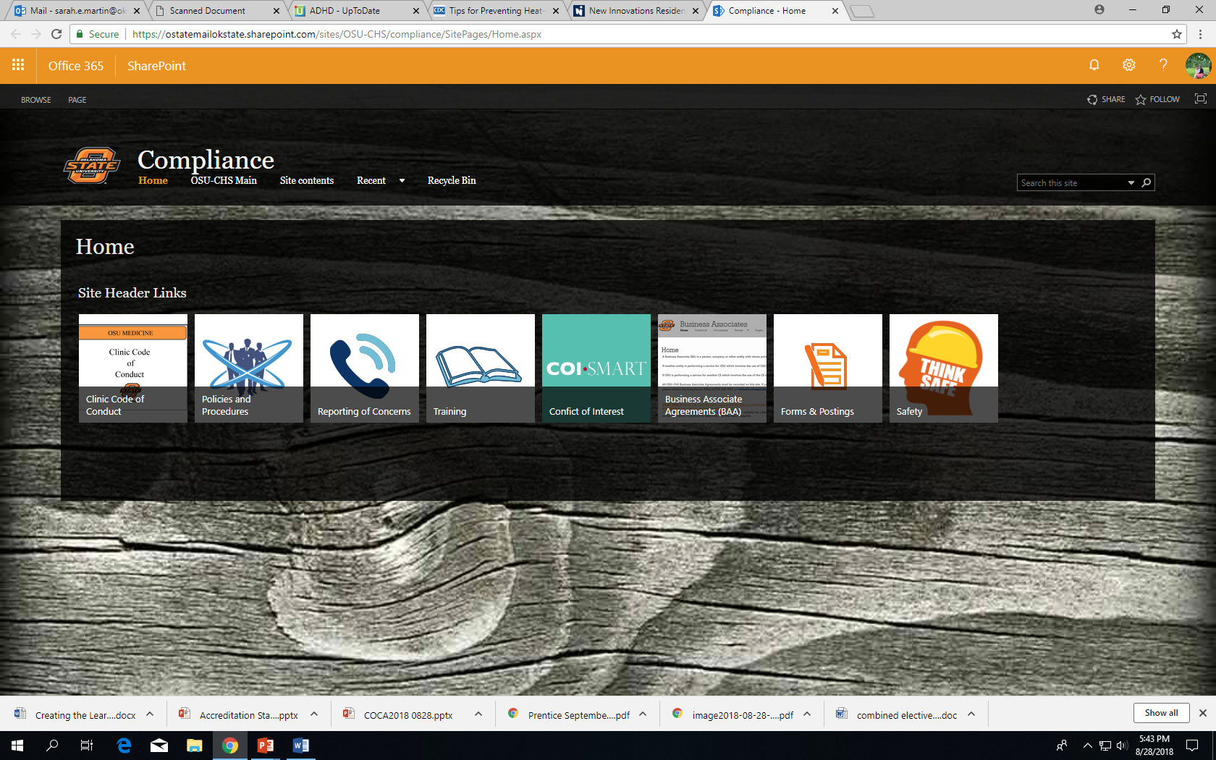

Slide 43


Slide 44
5.3 Health and Wellness
The Department of Wellness offers programs and services to help provide a healthy lifestyle environment for student, faculty and staff. Our mission is to enhance the quality of life for our students, staff and faculty through improved physical and mental development that leads to a healthy and rewarding life.
Kelly Dunn, M.D.-Medical Director of Student and Resident Wellness
Recently joined our faculty in July 2018
Wellness Committee created in 2016
Chair-Vivian Stevens, Ph.D.
Resident Wellness Subcommittee-Dr. Sarah Hall (chair)
Evaluation and Assessment Subcommittee-Alicia Ford, Ph.D. (chair)
Medical Student Wellness Subcommittee-Vivian Stevens, Ph.D. (chair)

Slide 45
5.4 Patient Care Supervision (CORE)
“A COM must ensure that osteopathic students in clinical learning situations involving patient care are under direct supervision by a licensed health care professional at all times in order to ensure safety. The COM must ensure that all supervised activities are within the scope of practice of the supervising health care professional. Students must have clear guidelines on their role in care and the limits of their scope of authority.”

Slide 46
5.4 Patient Care Supervision
Students in the 3rd and 4th year rotations are assigned through the office of Clinical Education
Carefully selected faculty and sites
Faculty Development
Annual CV review
Annual Verification of licensure and current board certificate status
Copies kept with Department Chairs and also Administration, very important that they are current

Slide 47
Key Stakeholders
Patty White-Safety Manager
Jennifer Nachbor- Occupational/ Student Health Nurse
Jesse Chaffin-Health and Wellness Manager
Kelly Dunn, M.D.-Director of student and resident wellness
Vivian Stevens, Ph.D.-Chair of the Wellness Committee
Tina Tappana-Director of Human Resources
Angela Bacon-Director of Student Affairs

Slide 48
Questions
Thank you for your time and attention

